Slide 1
Modeling US large Bluefin tuna spatial density using VAST

Slide 2
Goals
Apply spatial-temporal models to develop improved indices of abundance for the western BFT stock
Apply VAST modeling to US-only large BFT data, making use of concurrently-developed VAST model of prey density
Apply VAST modeling to joint US-Canadian large BFT data, cannot use prey density as a covariate due to lack of data

Slide 3
Goals
Apply spatial-temporal models to develop improved indices of abundance for the western BFT stock
Apply VAST modeling to US-only large BFT data, making use of concurrently-developed VAST model of prey density
Apply VAST modeling to joint US-Canadian large BFT data, cannot use prey density as a covariate due to lack of data

Slide 4
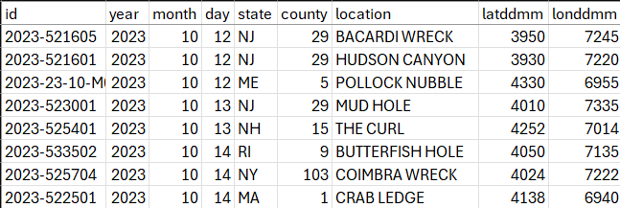
Pre-modeling data cleaning
Assigned degree-minute (DDMM) spatial location to some fishing events previously missing this information
Assumed DDMM from combination of state landed, county landed, and fishing ground name information provided by fishers
Accuracy of assumed spatial information is likely on par with accuracy of DDMM spatial information provided by fishers
Adds ~1000 records
Notes:
Dataframe of all LPS interviews includes many fishing events with no missing information, used this to make assumption of DDMM fishing location based on state/ county landed and name of fishing grounds
Colloquial names of fishing grounds and DDMM lat-lon of fishing events within them are surprisingly consistent
Double-checked consistency of fishing grounds against common fisherman resources, like Captain Seagull fishing charts
VAST grid eventually used for interpolation of density has 22km by 22km grid cells, washing out much spatial variation at finer resolutions anyway.

Slide 5
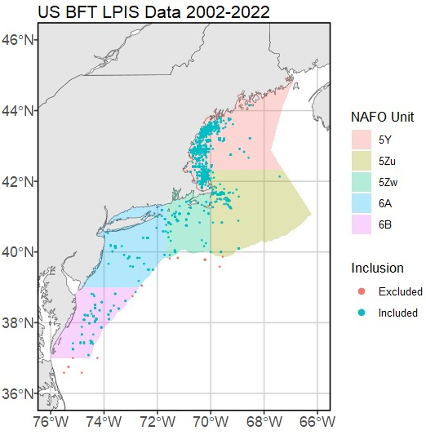
Peeking at the data
Samples between the Chesapeake and Hatteras (NAFO area 6C) excluded, too few to be representative
Samples offshore from the continental margin excluded, too few to be representative
Not a big data loss– around 25 samples

Slide 6
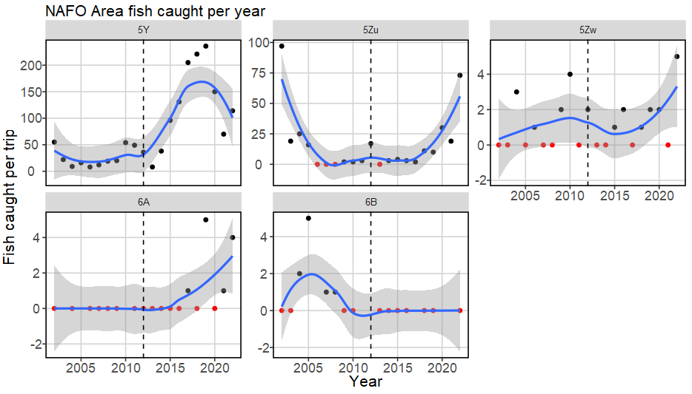
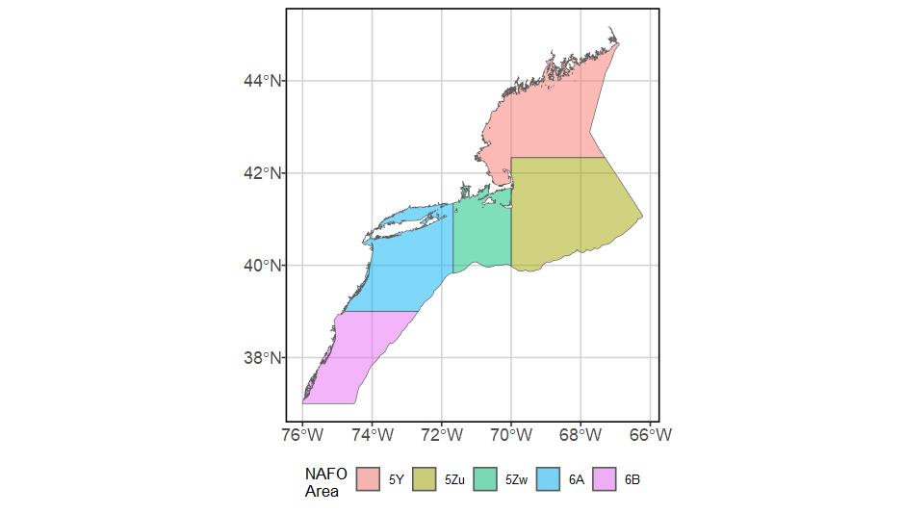
Peeking at the data
54980 sq km
65230 sq km
24488 sq km
43950 sq km
32917 sq km
Notes:
All strata but Gulf of Maine and Georges Bank (5Y and 5Zu) have too few fish caught per year to model presence/absence, let alone positive catch rate.
Georges Bank strata has long period (2006 – 2017) of low success, making it difficult to model positive catch rate.
For all strata, most trips land 1 fish. This lack of variation makes it really hard to model positive catch rate.

Slide 7
Model structuring – domains
Spatial domain: Gulf of Maine ONLY (NAFO Unit 5Y)
GOM represents 80% of all BFT effort in US waters
Temporal domain: 2002-2022
Too few unsuccessful fishing efforts recorded prior to 2002
Results from 2022 have excessively poor fit: huge confidence intervals and dramatically different results given trends of prior five years
Choosing to include 2022 in model but not interpret results from this year due to low confidence in realism of results
Potential fix is adding 2023 data (in the works)

Slide 8
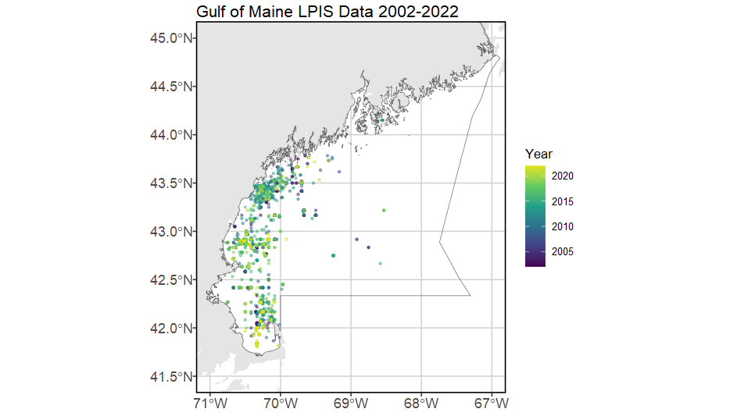
Model structuring – domains
Notes:
Gulf of Maine only (area has 80% of coastwide US effort). Temporal domain 2002-2022. No samples east of 69deg. No samples from June or July 2020 (no observer coverage to make prey model for this period, and VAST cannot handle missing values in density covariates). Looking to incorporate 2023 data with completion of new prey VAST model. Data from 2022 included, fitted, but not interpreted in results due to excessively poor fit.

Slide 9
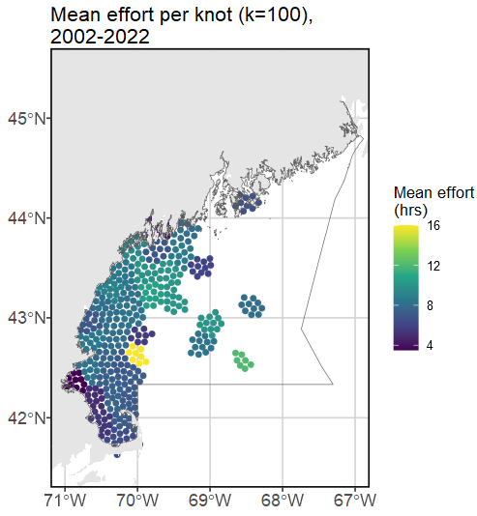
Spotting a problem
Massive spatial and temporal gaps in sampling
Model must extrapolate encounter probability/ positive catch rates in space from far-away sampling points
Only 12 samples east of 69°W in the 20-year time series. They would have an extremely unbalanced influence on more than half of the spatial area of NAFO Unit 5Y (~29,200 sq km / ~55,000 sq km).
Samples east of 69°W deemed unrepresentative, removed
Fippennies & Cashes

Slide 10
Model structuring – data inputs
Number of fish caught = response
Do not have biomass information for every fish, must use abundance instead
Fishing hours (time spent explicitly fishing, not steaming) = effort
Number of lines as catchability covariate for both linear predictors
Thinking that more lines in the water likely affects both likelihood of encountering fish AND the positive catch rate.
Have to remove like 12 samples that have missing # of lines data

Slide 11
Spotting another problem
Limited capture success
7950 samples in the Gulf of Maine with all necessary environmental and spatial information. 1480 instances of capture, only 77 of which were multiple fish.
A few years have under 10 fish landed in total – 2004, 2006, 2013.
This is not enough contrast to provide useful information to the second linear predictor, positive catch rate (abundance).
Model fails every time, with every reasonable structure, if spatial and spatio-temporal effects are left on for the 2nd linear predictor.
End result: drop spatial and spatio-temporal effects for the 2nd linear predictor

Slide 12
Model structuring – spatio-temporal variation
No geometric anisotropy – fails to converge when turned on
Indicates equal rate of change across alongshore and offshore axes
Caused by limited spatial extent covered by samples, infrequent capture of multiple fish, and/or highly migratory nature of the fish?
1st linear predictor (presence/absence)
Prey, SST, AMO, bathymetry used as density covariates
NAO dropped (no noticeable effect)
Temporal structure (random walk) of spatiotemporal variance, fixed effects for each year’s intercept
2nd linear predictor (positive catch)
No spatial or spatiotemporal variation (too few times where >1 fish caught)
Temporal variation is a random effect independent for every year

Slide 13
Density covariate updates
SST
¼ deg spatial resolution, daily timestep
Depth
GEBCO 15 arc-second interpolated grid
AMO
Monthly timestep
Prey
Spatiotemporal density from VAST model using observer data inputs, monthly timestep
Notes:
The problem with AMO: it should have a greater effect but every year included in this model is a “positive phase” year. We have limited contrast to notice an effect. Strongest annual AMO signal for the entire time series is in 2022, weakest in 2002.

Slide 14
Density covariate model formula
Natural splines
Allows for piecewise polynomial relationships across the bulk of the data but force linear relationships at the min/ max bounds.
Reduces unrealistic relationships due to low sampling density at min/ max bounds.
5 degrees of freedom
Thus, four “internal” knots at 20, 40, 60, and 80% quantiles. Also has two “external” knots at min and max bounds.

Slide 15
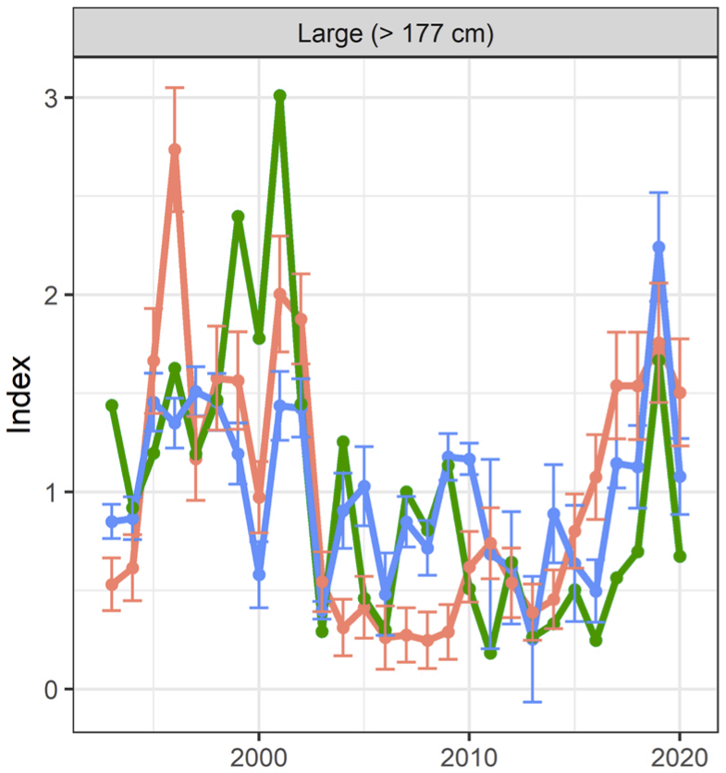
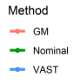
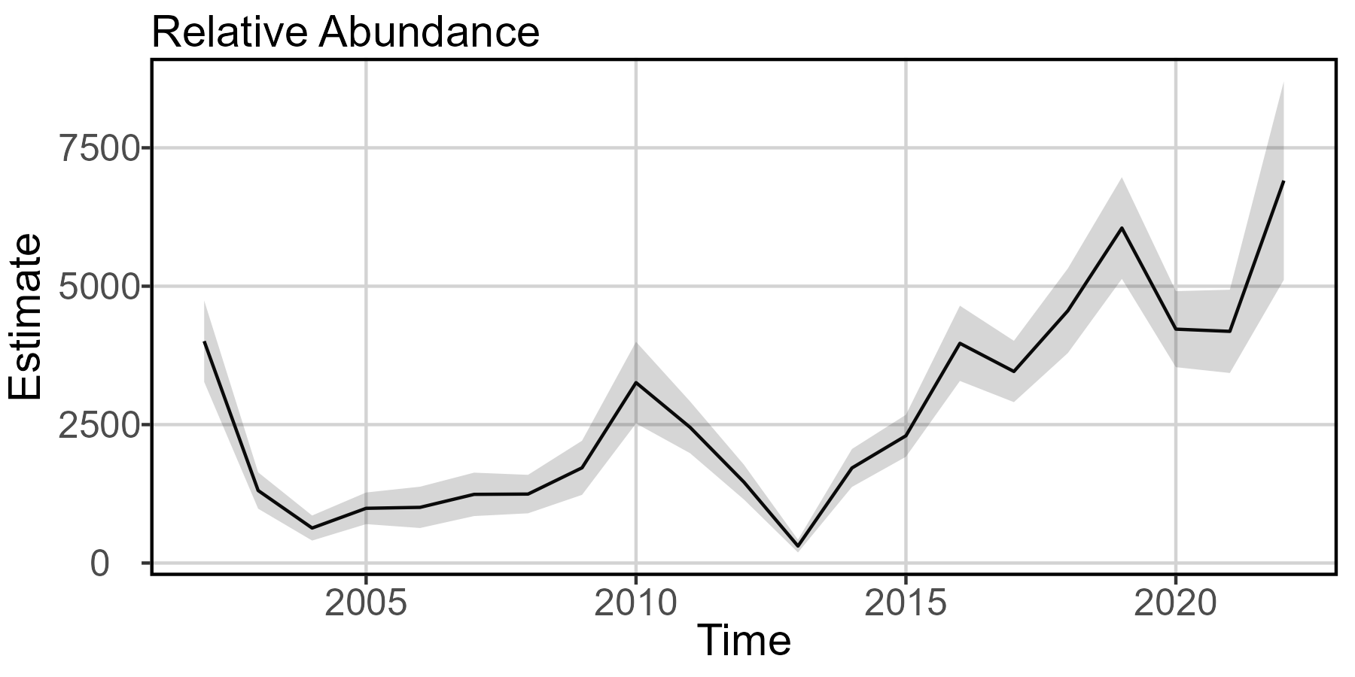
Indices of relative abundance
Hansell et al 2022
Current
Notes:
Old – Blue is VAST. Local minima at 2003 and 2013, local maxima at 2002, 2009, 2019. Model ends with dip at 2020.
New – local minima at 2004 and 2013, local maxima at 2002, 2010, 2019. Results at 2022 should not be interpreted.

Slide 16
Index of relative abundance takeaways
Model comparison
Old & new models indicate declines 2002-3/4, slow recovery through 2010
Old & new models show time-series-low abundance in 2013
Old & new models show increasing population since 2013, hit time-series-high abundance in 2019
Ecological meaning
Matching trends regardless of differing spatial extents highlights how GOM is the driver of US BFT abundance
What caused the rapid drop at 2013?
Continuation of decline beginning in 2010?
“Wicked Tuna Effect” after new entrants from 2012 premiere?
Lagging disturbance effect of massive marine heatwave in 2012?

Slide 17
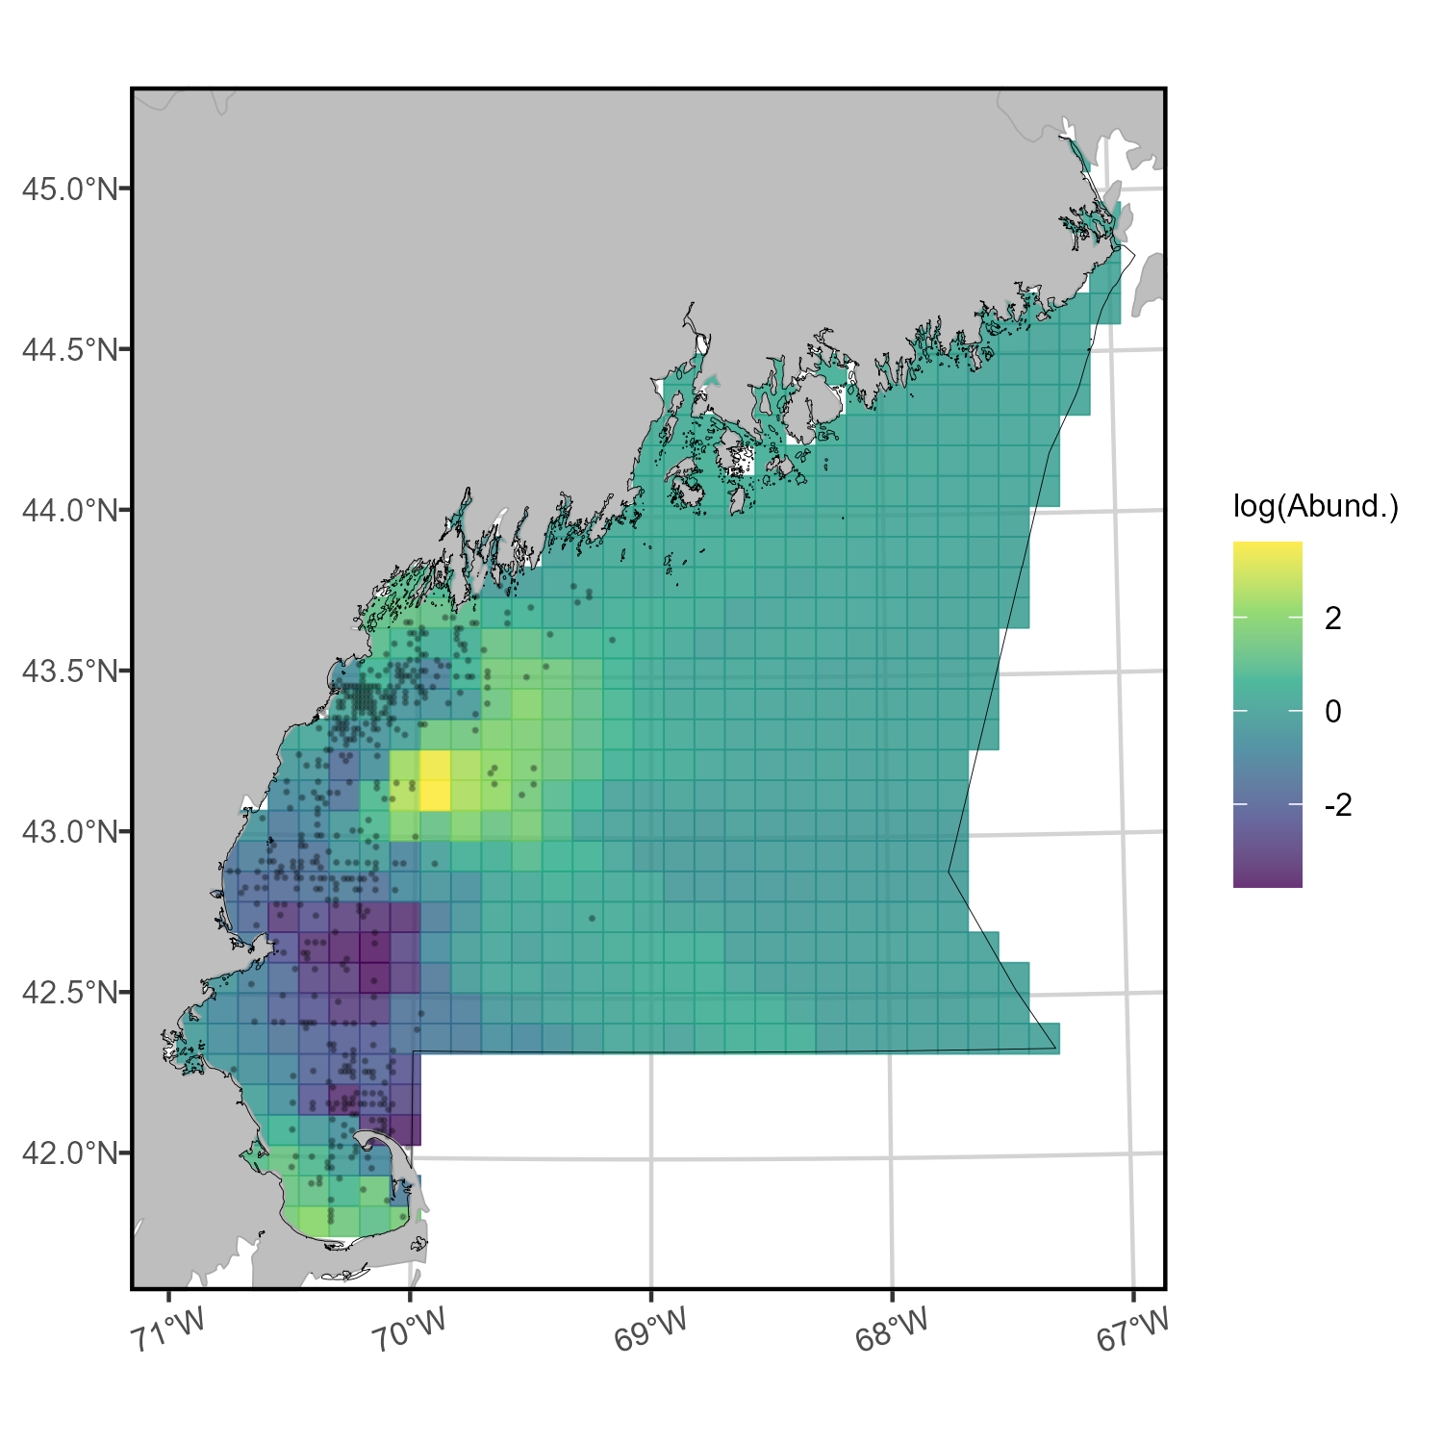

Mapping spatial density
Difficult to assess
abundance within
area east of 69°,
low confidence.
Persistent hot spot
Scaled
log(Abund)
Persistent cold spot
Notes:
Temporal maps of density also provided to you in separate file. Is too small for detail on ppt slide.
This plot is SUMMED SPATIAL DENSITY. Or, the cumulative relative abundance of fish within each grid cell, summed over time.

Slide 18
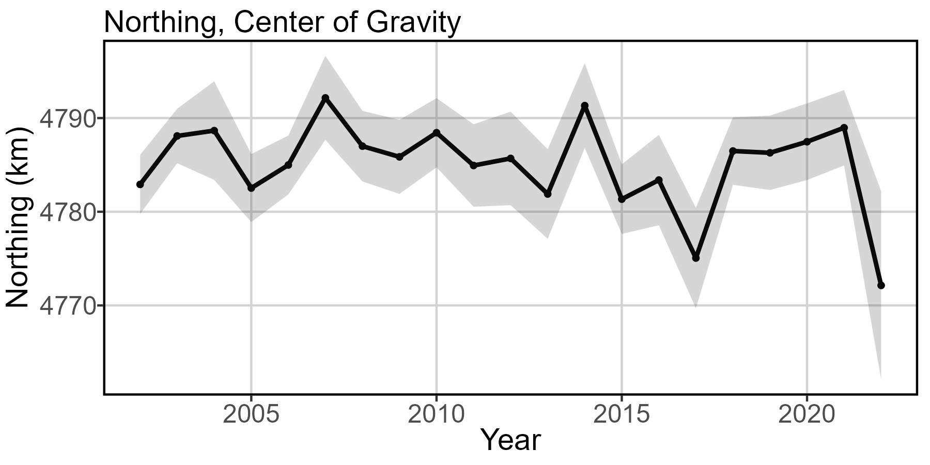
Center of gravity
Notes:
Model with GMRF, spatial and spatio-temporal effects turned on for linear predictor 1 (off for 2), temporal effects for both linear predictors, all chosen density covariates.
Low confidence in results from 2022, recommend including data in model development but no interpretation of results in this year.

Slide 19
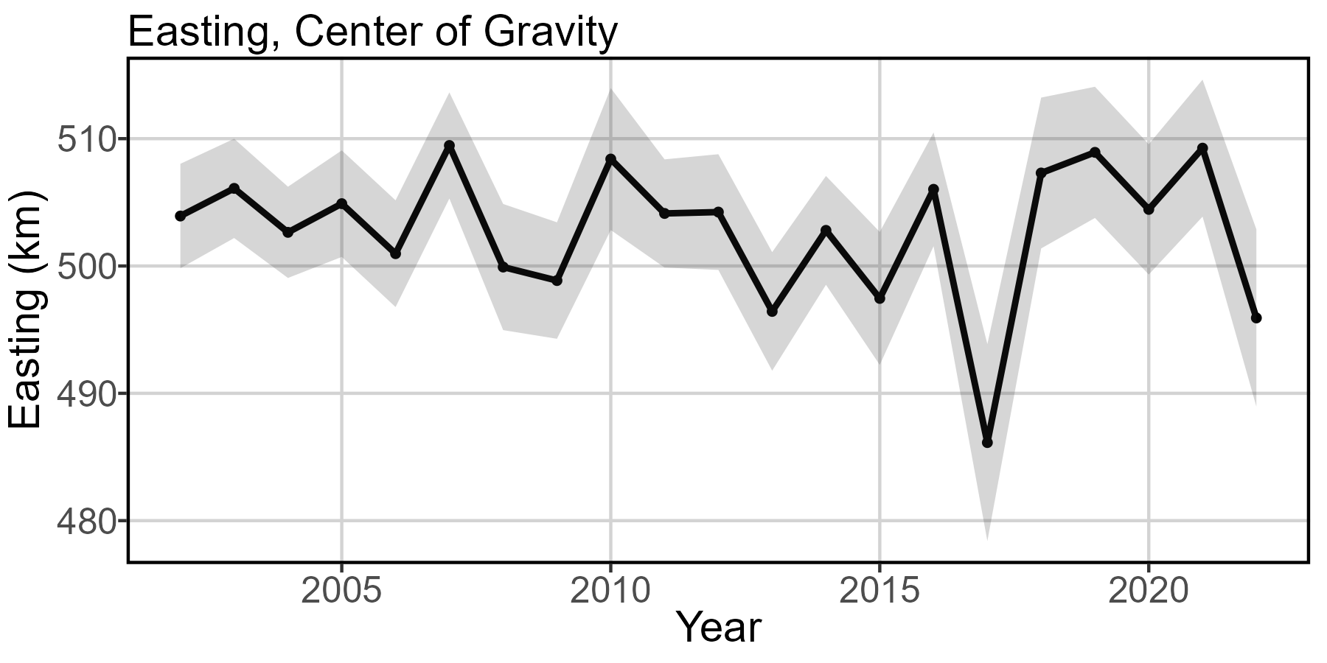
Center of gravity
Notes:
Model with GMRF, spatial and spatio-temporal effects turned on for linear predictor 1 (off for 2), temporal effects for both linear predictors, all chosen density covariates.
Low confidence in results from 2022, recommend including data in model development but no interpretation of results in this year.

Slide 20
Center of gravity takeaways
Model comparison
Old model: 1km/ yr northward and 2km/ yr eastward shift, but uses entire US continental shelf, 1993-2020
Updated model: 0.07 km/ yr SOUTH and 0.02 km/ yr WEST in Gulf of Maine, 2002-2021
Ecological meaning
Fish, fishers, or both are condensing into the near-coastal region of GOM between Gloucester and Portland
Model results could reflect a shift in spatio-temporal effort distribution and intensity more than spatio-temporal changes in BFT productivity or distribution
Dip in 2017: probably driven by unusually high hours-per-catch at Fippennies Ledge, artificially shrinks range inshore. Also notable: SST anomalously cold in 2017 as compared to the rest of the time series.

Slide 21
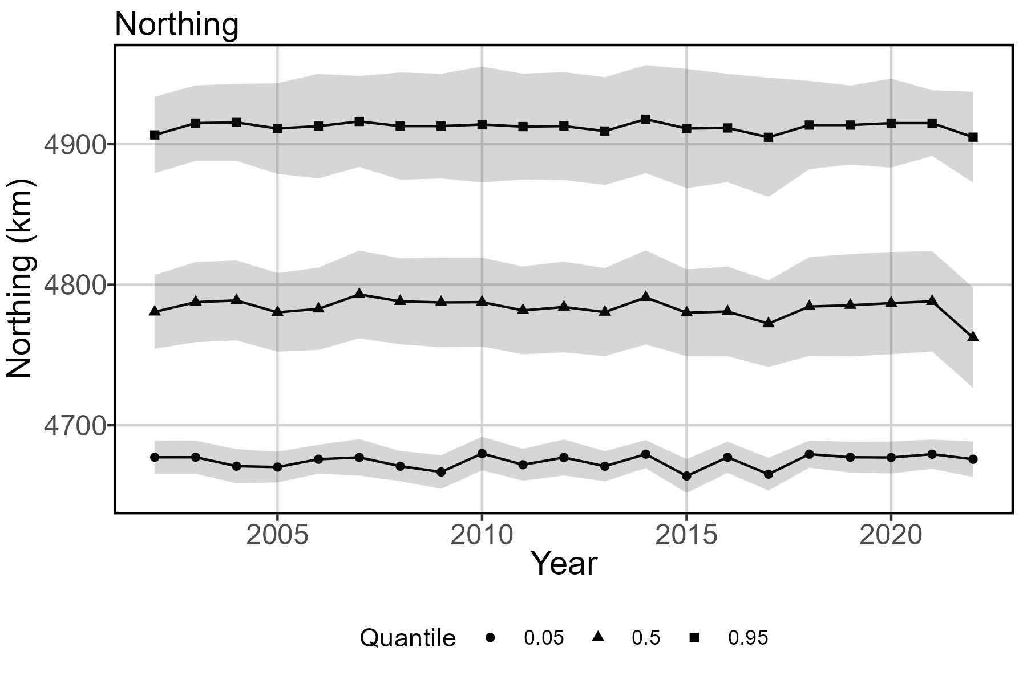
Range Edges
Notes:
Results from 2022 should not be interpreted.

Slide 22
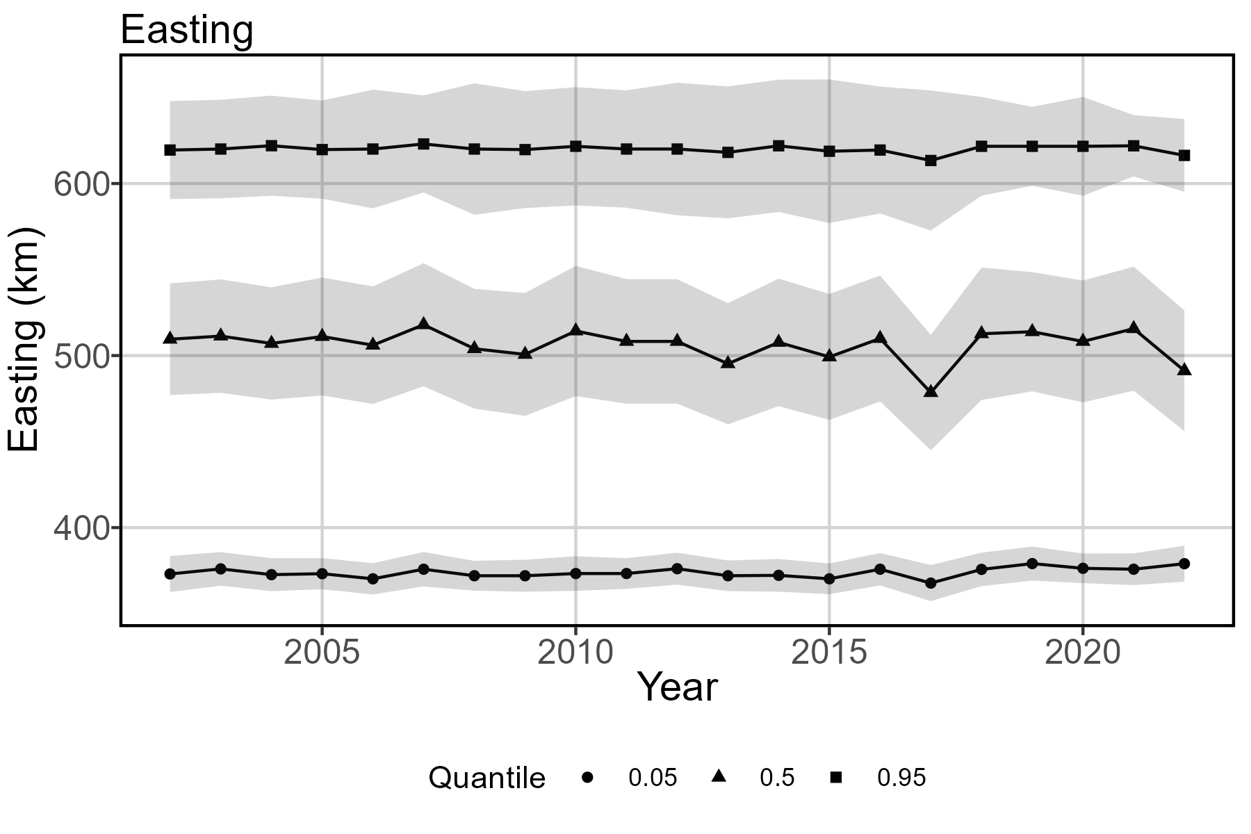
Range Edges
Notes:
Results from 2022 should not be interpreted.

Slide 23
Range edge takeaways
Ecological meaning
0.05 quantile shifts north (~0.10 km/ yr) and east (~0.11 km/ yr)
0.5 quantile shifts SOUTH (~ 0.11 km/yr ) and WEST (~0.18 km/yr)
0.95 quantile is not super informative given artificial break conforming to international boundaries. Tons more tuna in SWNS and GSL not accounted for. But here, shows negligible change
Overall: slight habitat loss at southwestern corner, while center of gravity and 0.5 quantile show shifts inshore and south
Noticeable (though slight) northward habitat compression is concerning given southward shift in fish density and fishing effort over time

Slide 24
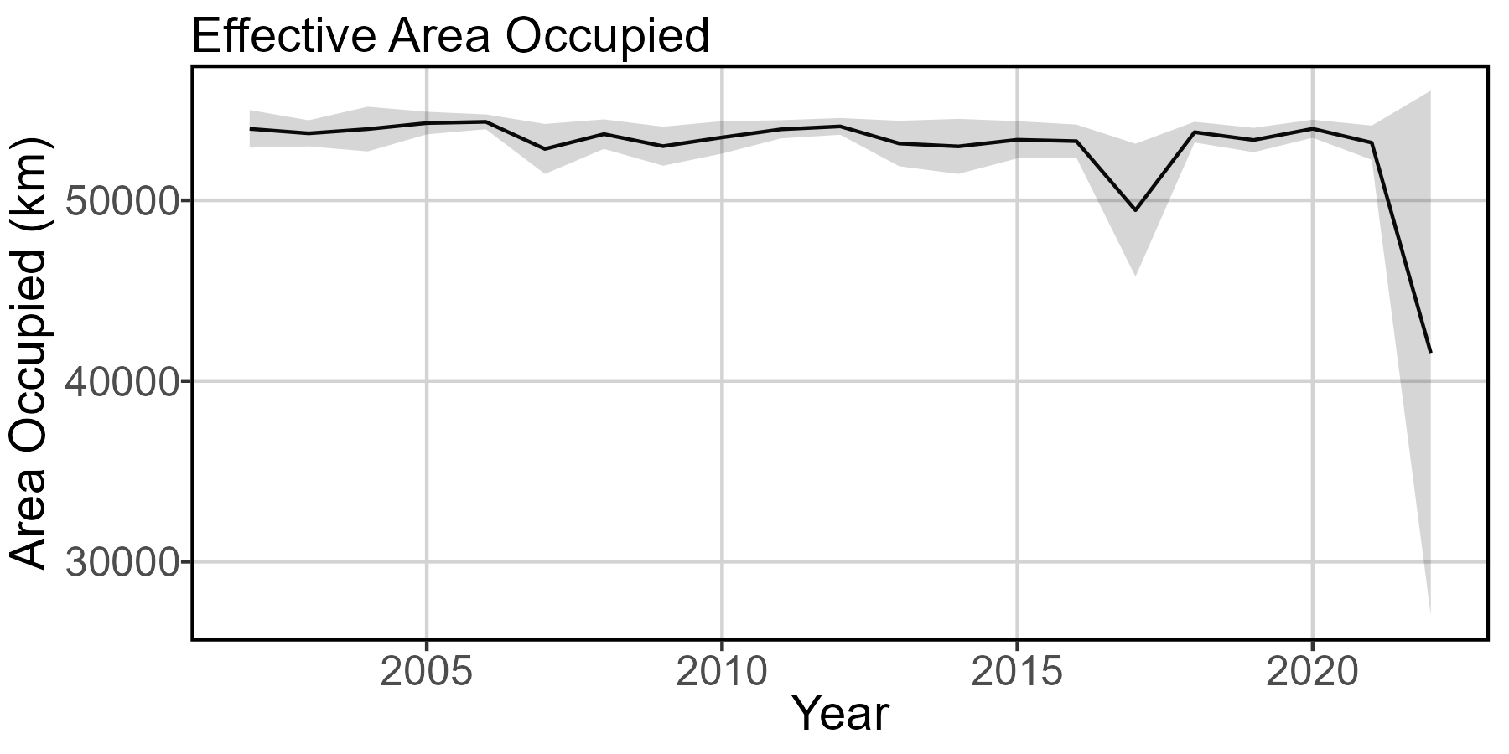
Effective area occupied
Notes:
Results from 2022 should not be interpreted. Relatively consistent, which makes sense since the spatial domain is only Gulf of Maine. Only noticeable feature is dip at 2017.

Slide 25
Effective area occupied takeaways
Ecological meaning
Small annual decrease in area occupied (average loss 59 sq km/ yr)
Makes sense given northward creep of southern range end

Slide 26
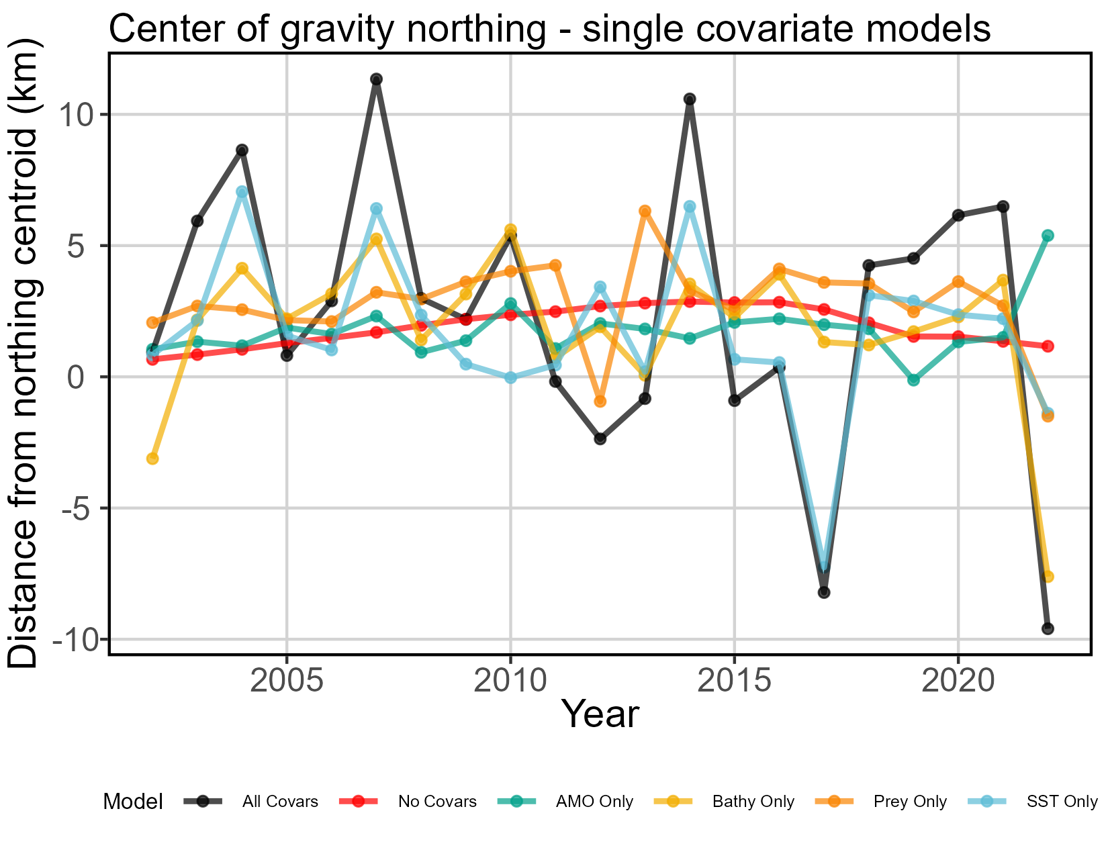
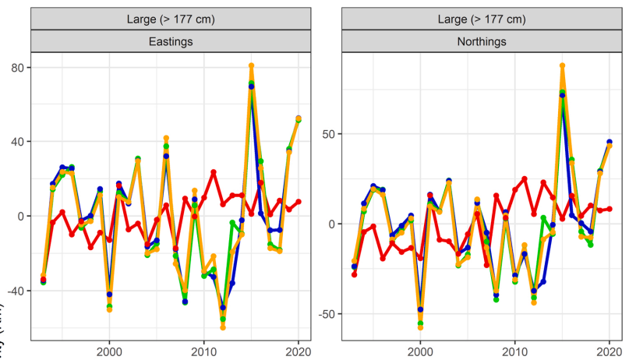
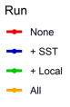
Relative explanatory power of density covariates
Notes:
All models have spatial and spatio-temporal effects turned off for second linear predictor

Slide 27
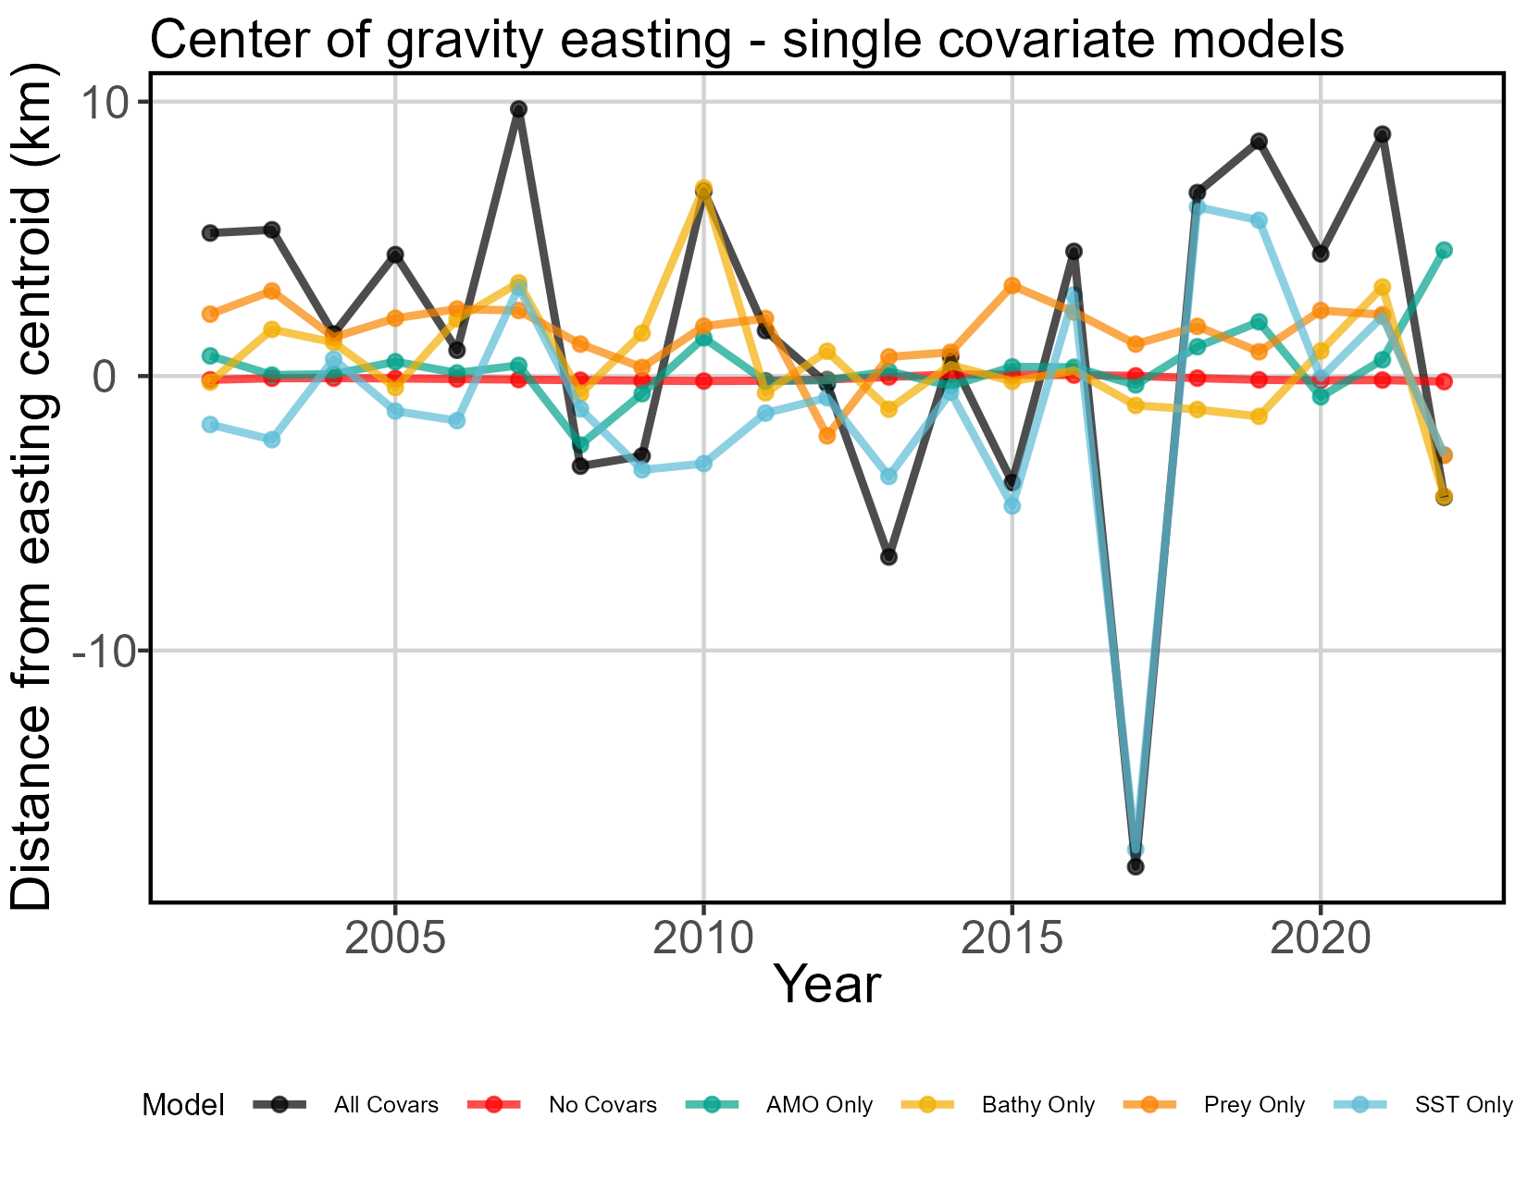
Relative explanatory power of density covariates
Notes:
All models have spatial and spatio-temporal effects turned off for second linear predictor

Slide 28
Relative explanatory power of covariates takeaways
Model comparison
Previous models found center of gravity shifts driven mostly by SST, that carries through to this model
Ecological meaning
AMO has little explanatory power for center of gravity shifts
Bathymetry and Prey as single covariates produce similar COG trends (except 2011-2013) and contribute little explanatory power
Bathymetry is temporally static, but the depth preference of fishermen (and perhaps the fish themselves) is not.
Notes:
Again, consider the problem with AMO: 2002-2022 are all positive phase years of varying strength. We have no negative phase years as a comparison.

Slide 29
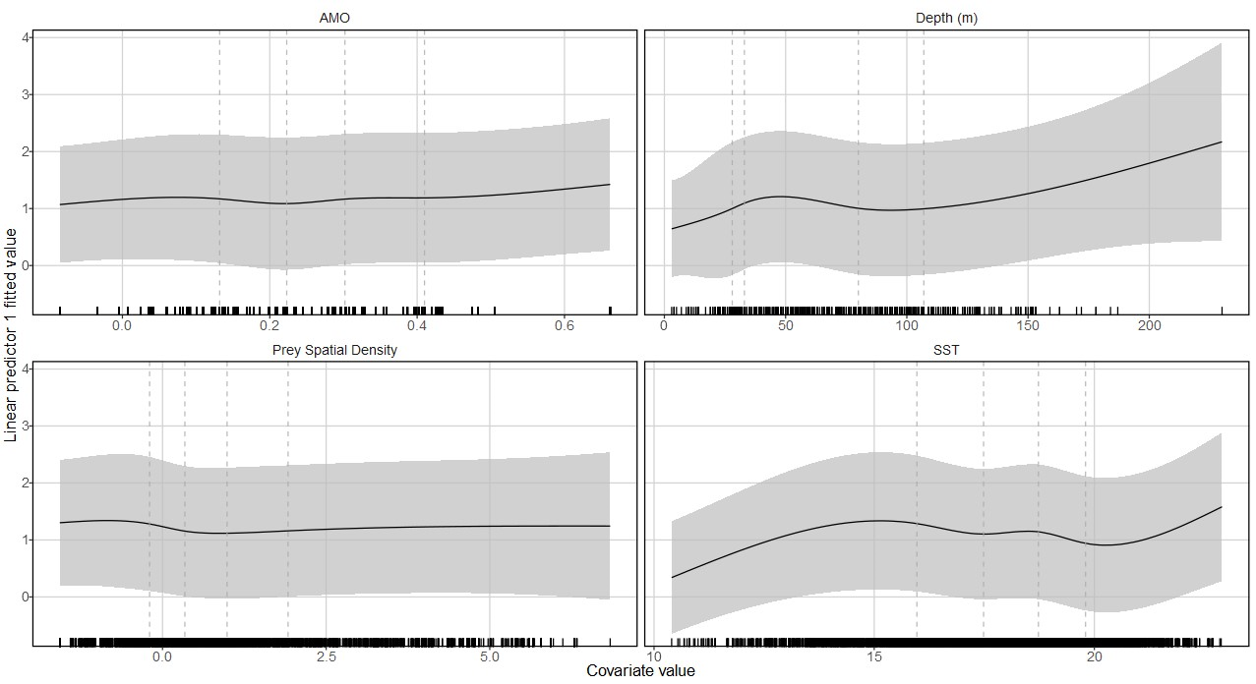
Density Covariate Marginal Effects
Notes:
Dashed vertical lines are where internal knots are placed (0.2, 0.4, 0.6, 0.8 quantiles).
A problem: 2022 data included in this result. Cannot really be parsed out.
All marginal effects shown are for first linear predictor (presence/absence)
Increasing AMO strength increases presence likelihood, near-linear
Depth relationship hard to assess given strong nearshore feature preference of fishermen. Unsure if presence increases with depth to this degree after ~105m.
Very limited effect of prey density. Likely that the prey model “soaks up” spatio-temporal effect of SST on prey, though pre-modeling checks don’t show correlation. Probably not much new in this density covariate.
Unsurprisingly, low and high SST translate to absence of BFT. Exponential increase in presence between 80% quantile and max SST probably not realistic. Local maxima at about 16°C.

Slide 30
Density covariate marginal effects takeaways
Ecological meaning
All marginal effects shown are for first linear predictor (presence/absence)
Increasing AMO strength increases presence likelihood, near-linear
Depth relationship hard to assess given strong nearshore feature preference of fishermen. Unsure if presence increases with depth to this degree after ~105m.
Very limited effect of prey density. Likely that the prey model “soaks up” spatio-temporal effect of SST on prey, though pre-modeling checks don’t show correlation. Probably not much new in this density covariate.
Unsurprisingly, low and high SST translate to absence of BFT. Exponential increase in presence between 80% quantile and max SST probably not realistic. Local maxima at about 16°C.
Notes:
Higher likelihood of presence at low prey density: are they biting because they’re hungry?

Slide 31
Overall
Comparison
Hansell et al. 2022 and updated model results too different to compare
Abundance
That being said, both models estimate a rapid drop in abundance 2010-2013, recovery since 2013
Center of gravity
Average annual center of gravity change is slight southwestward shift
Range shifts
Range edges and effective area occupied show slight habitat compression at southern edge of GOM.
Density covariates
Major driver is SST. Non-linear relationship between presence/absence and SST, with local peak presence rate at around 16C.
Obvious increase in SST through study spatiotemporal domain (avg 0.08 deg/yr). Also obvious increase in abundance through same temporal domain. Are BFT more adaptable to warmer water than we expect?

Slide 32
Thoughts
Looking coastwide and prior to 2002, we know that large BFT are targeted and captured less frequently in areas south of Georges Bank than they used to be
AMO may play a role in structuring this distribution shift
Focusing instead on GoM (where 80% of recorded effort occurs), spatial shifts are slight in our time series
Moving on to joint model will allow us to widen spatial scope and get a better grasp on large-scale spatial dynamics

Slide 33
Tweaks, next steps
Predicting prey spatiotemporal density in June and July 2020 (no observer data due to COVID)
Would allow for BFT data in these months to be reintroduced to model. In the works.
Incorporate 2023 data
LPIS data from 2023 recently published. Working on incorporating these data– but need to update prey model with 2023 observer data and the predicted 2020 data (in the works)
Drop 2022 from modeling efforts?
Previously, doing this caused models to fail. But the results are so poorly fitted and cannot be interpreted if kept in. If adding 2023 does not solve this issue, consider making 2021 the terminal year.
Turn on bias correction and re-run for final results
This is the last step. Once we’re happy with everything else, we do this.
Notes:
LPS Data Catalog: https://www.st.nmfs.noaa.gov/st1/recreational/LPS_Data/
Do we still want to do small tuna? I have the data ready to go and can reformat these models for small guys too.

Slide 34
BONUS SECTIONS Prey model and effort shifts

Slide 35
BFT Prey VAST model

Slide 36
Data input decisions
Prey spatial domain is US Continental Shelf + 10km (we lose maybe 5 samples that are more than 10km outside the continental shelf edge)
Full dataset includes many gear types and no measurements of effort
Without effort, was forced to choose one gear type. Went with otter trawls, as they are the most common gear across all three fishes. I know this is not likely data from directed fisheries– the forage fish are caught as bycatch. You’re not fishing smart if you’re looking for menhaden/ herring with a bottom trawl.
All samples assigned a unitless 1 effort value
Data can be modeled at monthly timestep and include category separations for herrings, mackerels, and menhaden. Later sum across fish types to get full prey field per month.
Each sampling event has a component for biomass of each prey group. Usually just one prey group is caught. This helps us add zeroes so the model has some contrast.
Notes:
Checked with Alex on the effort; it’s not recorded. He says there’s no easy way to come up with a measure of effort, either.

Slide 37
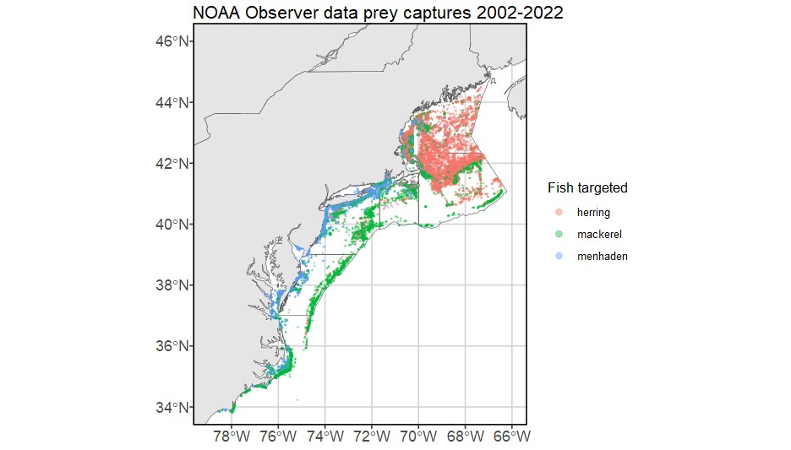
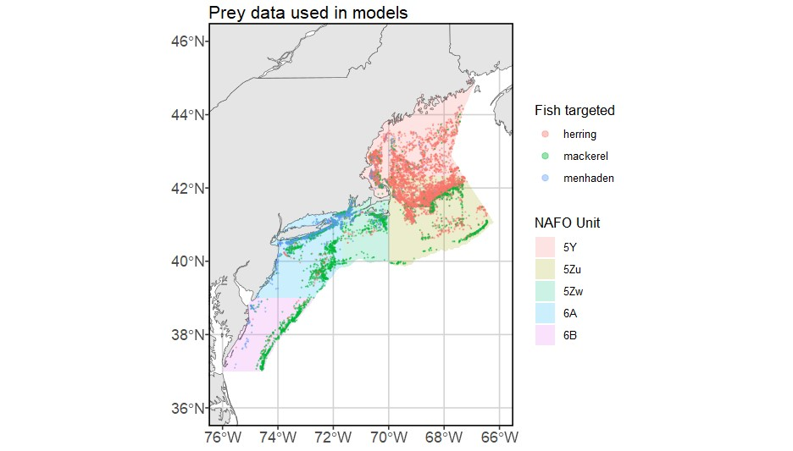
Spatial domain – Prey
Notes:
- Removed inshore estuary data and data from south of NAFO unit 6B
- Those weird bits in GoM/ GB that look like intentionally blank squares are closed areas in which trawling is not allowed.
- No inshore data north of Portland– does herring fishing happen up here? Are there just no observers to make a note of it? Not sure.

Slide 38
Model structuring decisions
Data availability does not support fine-scale spatial heterogeneity modeling, similar to the tuna models.
No density covariates! Just flat-out capture data.
Don’t want to introduce collinearity by using the same density covariates in this model, which will be later nested WITHIN the US-only tuna model anyway.
Spatio-temporal variation in the first linear predictor is a fixed random effect that follows an AR1 process
Variance is therefore estimated as fixed effects with a separate first-order autoregressive parameter for each category
These hyperparameters are copied to the second linear predictor. This makes sense, we must link presence/absence and abundance anyway because we have limited amount of data where fish were not captured.

Slide 39
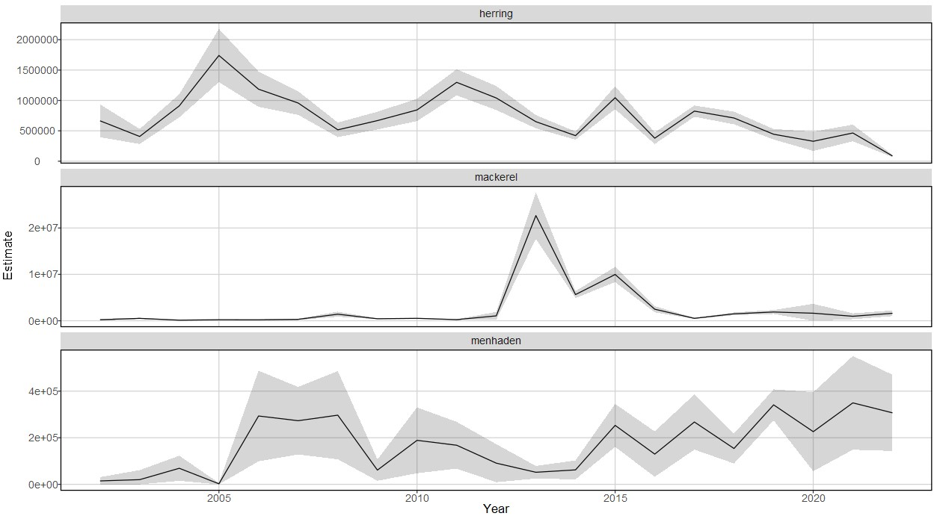
Annual relative indices of abundance
Notes:
Herring abundance decreasing with time. Lowest historical abundance (in model temporal domain) in 2022.
Mackerel have massive variation 2013-2015. Otherwise, relatively low abundance. I think targeting mackerel is opportunistic, or maybe they’re just common bycatch.
Menhaden abundance relatively low compared to herring throughout time series, but increasing since 2014.

Slide 40
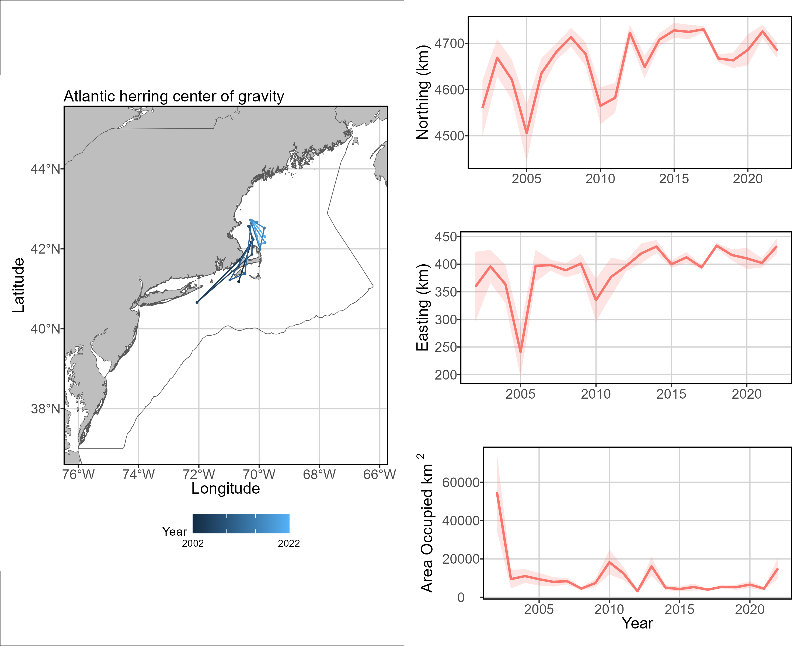
Distribution shifts
Notes:
Other than whatever weirdness happened in 2005 to pull the center of gravity down to the NYB area, this looks reasonable to me. Stock COG is mostly in the vicinity of Stellwagen Bank with possible 20-50km northward shift in 20 years.

Slide 41
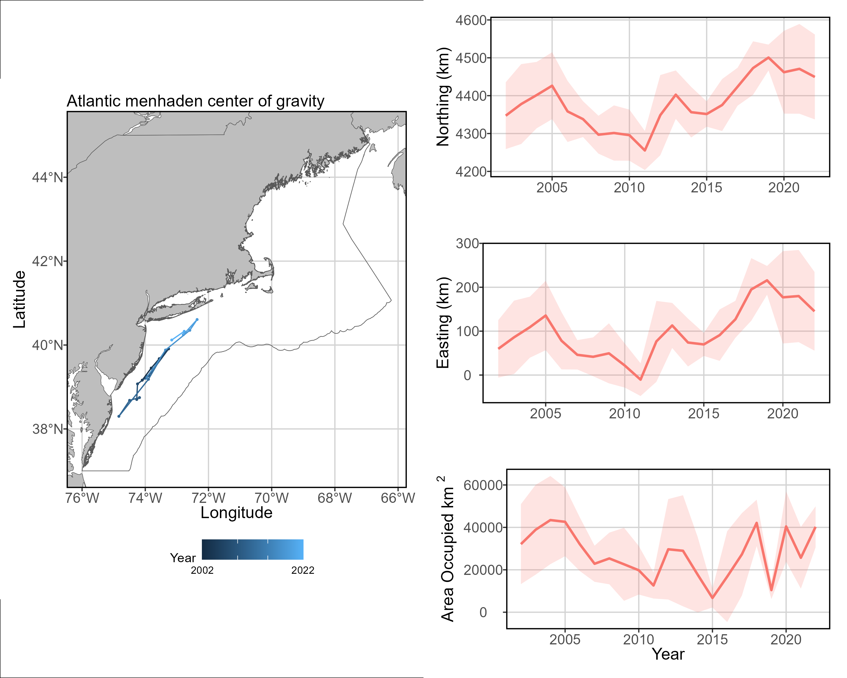
Distribution shifts
Notes:
This one’s pretty cool and matches what we know about declining recruitment from Chesapeake Bay and an otherwise healthy population. Examination of range edges (results not reproduced in this PPT) indicates that new or increased productivity in the north is expanding the range edge northward into the GOM and pulling the center of gravity with it. Also see incredible increase in productivity along south shore of Long Island since 2015. Anecdotal fisherman evidence that BFT catch along Long Island coast exploded in late 2010s (like, you could take a center console out of Rockaway Inlet and bring your tuna back into Brooklyn/Queens by nightfall). Thinking this is probably related.

Slide 42
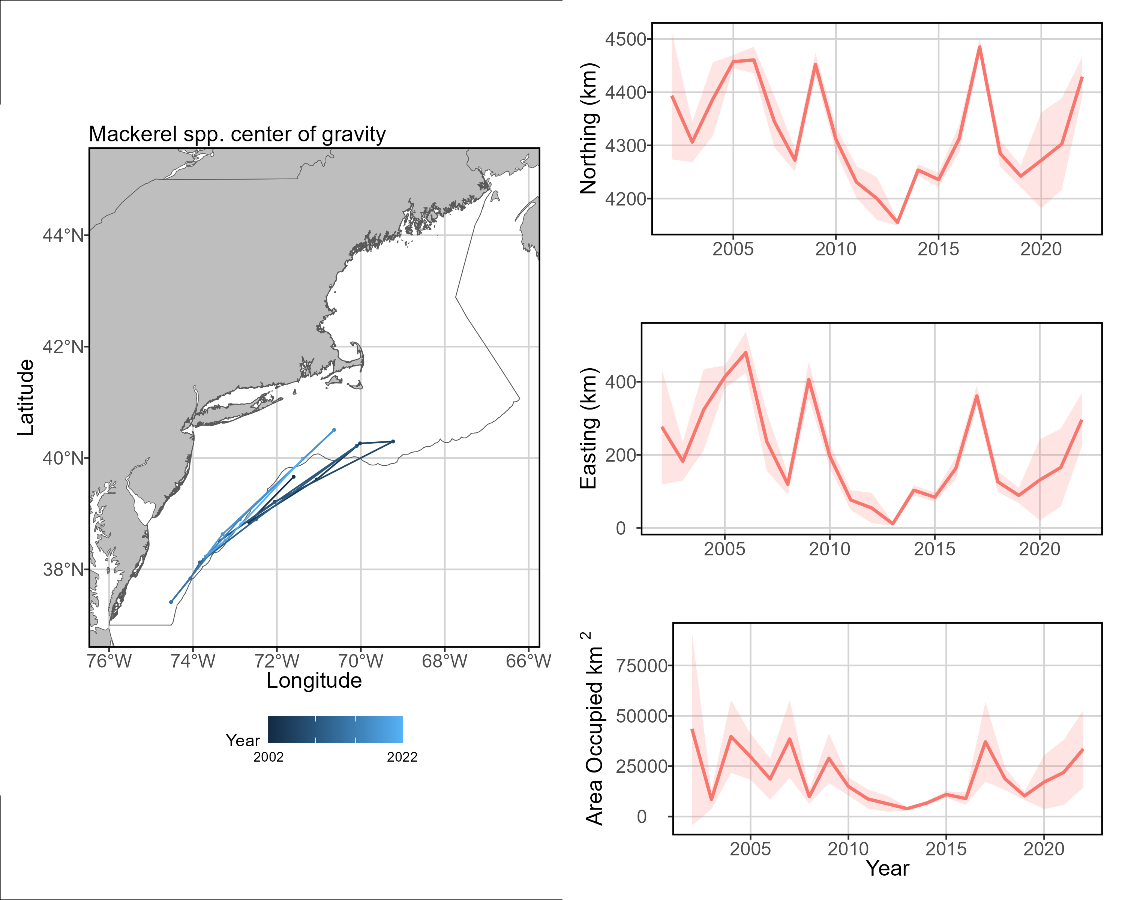
Distribution shifts
Notes:
Given the southern and offshore centers of gravity, I’m not sure how important mackerel are to BFT diets relative to herring and menhaden. OR, and more likely, we just don’t have enough data to make a stable model.

Slide 43
Considerations and improvements
No observer data from June or July 2020, means we have to discard tuna trips in this time because there is no prey field data. Working on predicting prey spatial density in those months.
Don’t have complete data from 2023. Would love to see it, if it’s QA/QC’d and ready. Else, I will use predicted values from VAST outputs.

Slide 44
Shifts in US Large BFT fishery spatio-temporal effort

Slide 45
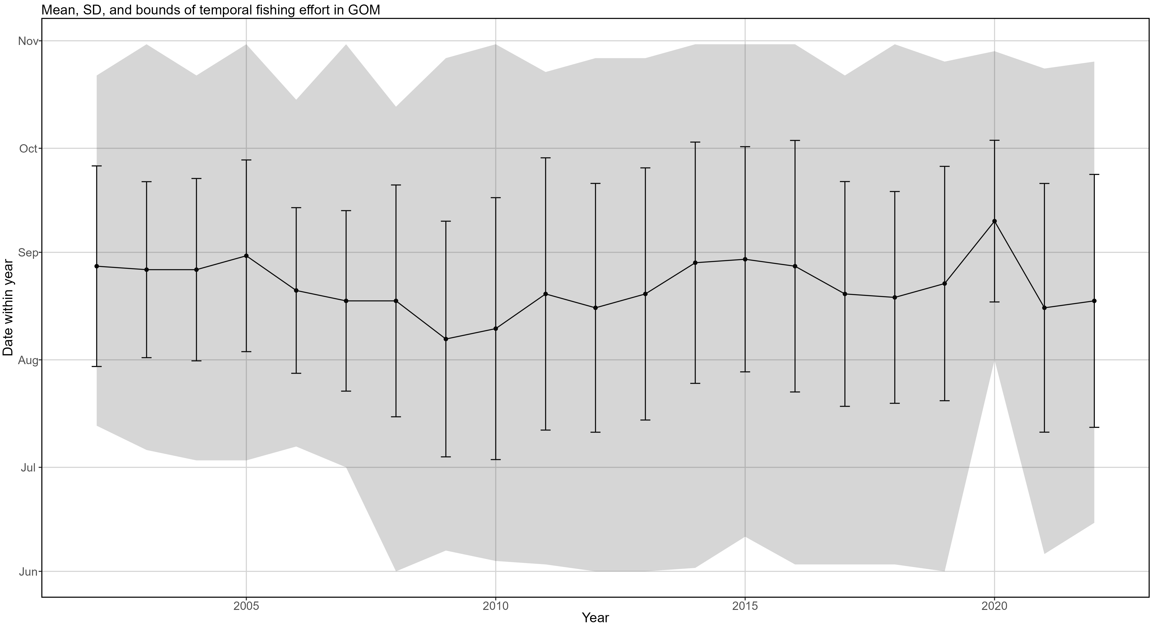
Temporal shifts in effort
LPS fishing occurred in this time, but is not included in modeling efforts because COVID stopped NOAA observers from going to sea, and therefore there is no prey density covariate
Notes:
Error bars: +/- 1 SD. Point: mean date in year. Shaded region: min and max date for fishing events included in model.
Fishing in June did not begin until 2008.
2020 June-July trips artificially missing from modeling efforts (missing prey data from NOAA observers, had to exclude)
Fishing events mostly occur in August – mid-September.
Fishing effort condensed in earlier years of time series. 2010-present sees more effort over longer period.

Slide 46
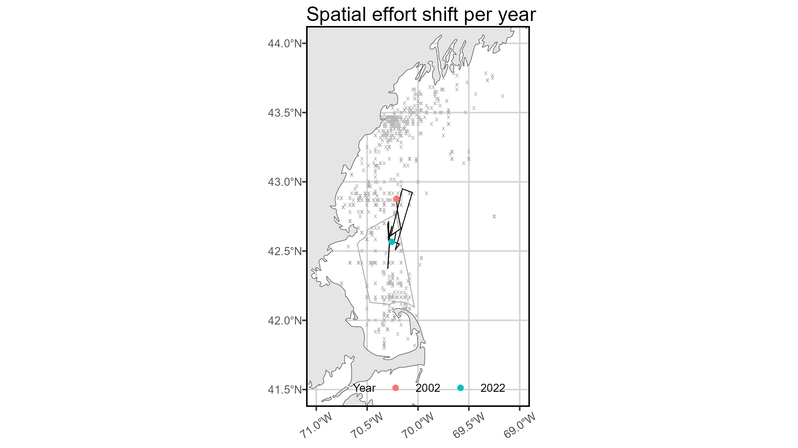
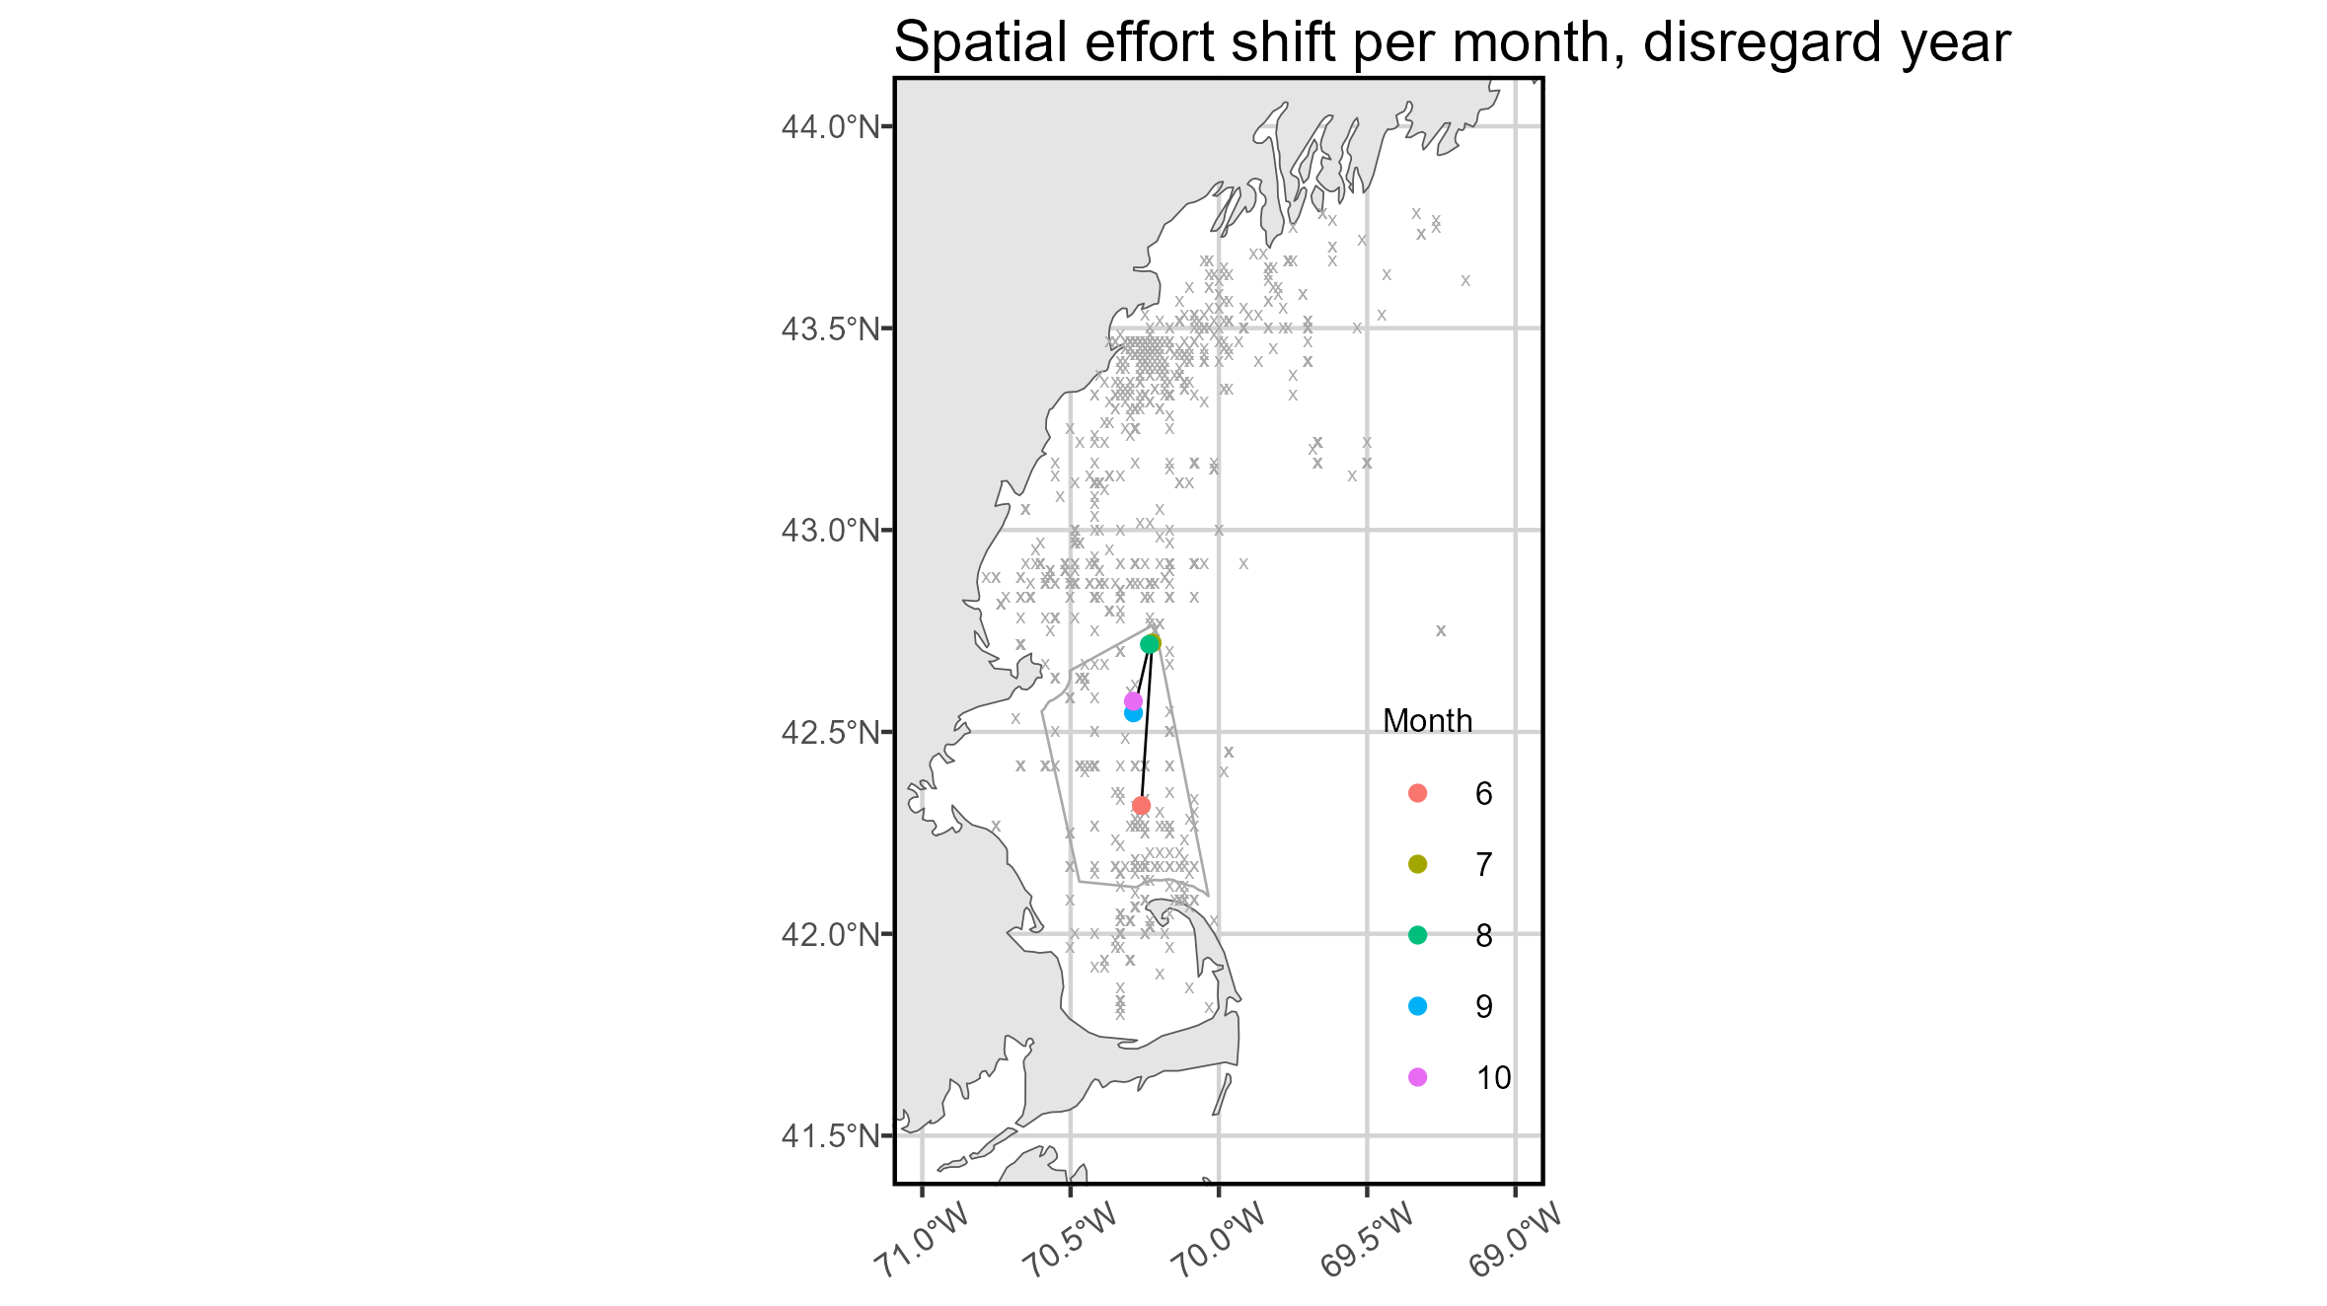
Annual and monthly shifts in effort
Notes:
Gray box is Stellwagen NMS
Effort has shifted southwest over time series.
Interesting parabolic south-north-south monthly shift in effort.

Slide 47
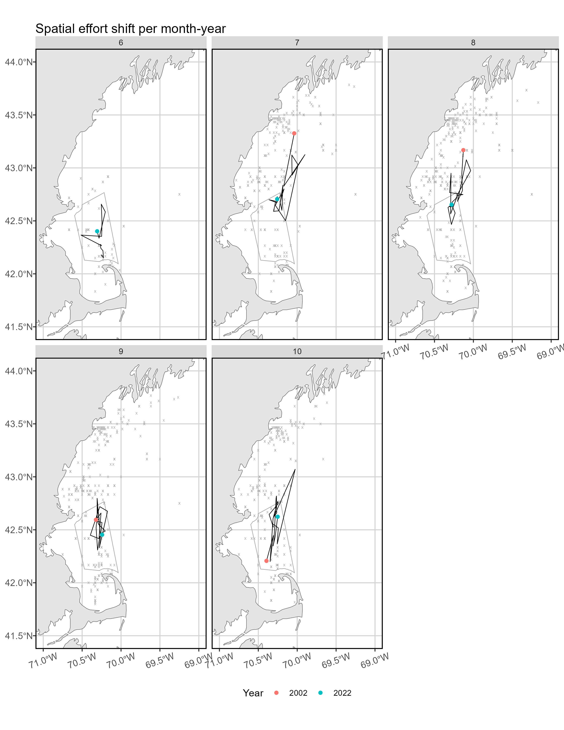
Yearly shift in effort per month

Slide 48
Yearly shift in effort per month
Notes:
Effort has shifted north in shoulder months (June, October) and south in major months (July-September).

Slide 49
What does this mean for the modeling
Spatio-temporal shifts in effort distribution and intensity have the potential to be “unseen hands” affecting time series of abundance, center of gravity, etc.
This is hard to account for in the US-only model, as most attempts to put any kind of temporal correlation structure on spatio-temporal effects caused the model to fail
As is, spatio-temporal variation for the first linear predictor is treated as a random effect with a random walk, rather than entirely independent between years. Hopefully this ameliorates the issue.

